Slide 1
Biome
First Last
First Last
References
reference
reference
“Quote”
~ First Last

Slide 2
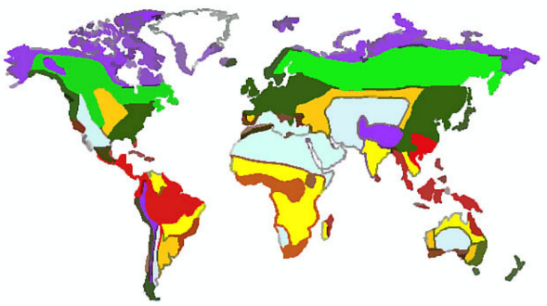
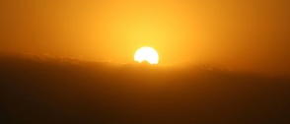
Food Chain
Biotic Factors - Animals
BIOME
Write a description of your biome
Biotic Factors - Plants

